Slide 1
Image: Wojciech Gajda/Photos.com
Image: Jupiterimages/Photos.com
Image: Christoph Hähnel/Photos.com
Image: Getty
Fourth Edition 2020
www.smilesforlifeoralhealth.org
Last Modified: November 2023
Copyright STFM 2005-2023
Notes:
This child oral health module is intended to educate all types of front line health workers who work under different titles & in many settings who:
- Have shared culture and are trusted members of the communities they serve
- Provide outreach, advocacy, patient education, care coordination, health care navigation, and social support
This workforce includes those with the following titles: community health workers and representatives, promotores de salud, health educators, case managers, care coordinators, public health or community health workers or community health advocates, health advisors or advocates, patient navigators, outreach workers, family resource workers, and peer health promoters.
This slide deck may be used as a basic introduction to Child Oral Heath. The complete FLHW resource curriculum, as well as the Smiles for Life curriculum, can be found at: www.smilesforlifeoralhealth.org.
If this child oral health module is used independent of other FLHW resource modules, the presentation may benefit from the use of interactive activities described in the first FLHW module (introductory module) or in the FLHW Handbook. The activities can be used individually or collectively to support deeper personal engagement and reflection.
You may elect to hide slides if you have time constraints or feel they do not add value to your presentation. Simply right-click and select the “Hide Slide” feature at the bottom or click the Slide Show tab and select “Hide Slide”.
Smiles for Life, 4th Edition
Copyright STFM 2005-2023

Slide 2
Course Authors
Smiles for Life Steering Committee
Anita Glicken, MSW
Melinda Clark, MD, MJ
Smiles for Life Editor
Karlynn Sievers, MD
Funded By
The images in this presentation are not to be reproduced/downloaded for purposes other than personal use. Republication, retransmission, reproduction, or other use of the Licensed Material is prohibited.
Notes:
Welcome to the Front Line Health Worker Child Oral Health Course
Acknowledgements:
Course Authors
Smiles for Life Steering Committee created the original content, from which these slides were adapted.
Anita Glicken, MSW
Melinda Clark, MD, MJ
Portions of this project were created in collaboration with Southwestern Connecticut AHEC, with funding support from the Connecticut Department of Public Health (CT DPH). Smiles for Life is grateful for these partners in this work.
Smiles for Life Editor
Karlynn Sievers, MD
Funding Note:
Smiles for Life is made possible through the generous support of National Interprofessional Initiative on Oral Health (NIIOH) - a collaborative network of funders who share a common commitment to promoting oral health.
Portions of this project were supported by the Connecticut Department of Public Health (CT DPH) with funding through the Health Resources and Services Administration (HRSA) of the U.S. Department of Health and Human Services (HHS) under T12HP28885 Oral Health Workforce Grant for $1,200,000. This information or content and conclusions are those of the author and should not be construed as the official position or policy of, nor should any endorsements be inferred by CT DPH, HRSA, HHS or the U.S. Government.

Slide 3
3
Educational Objectives
Discuss relationship between oral health and overall health
Describe the prevalence, causes, and consequences of childhood tooth decay (Early Childhood Caries)
Understand prevention strategies and education tools to promote child oral health
Identify the role of FLHWs in promoting child oral health
Notes:
The overall goal of this module is to engage FLHW as active contributors to an expanding primary care oral health network that works in partnership with dental providers to improve oral health and prevent dental disease in children.
We will address educational objectives listed on this slide. Many are a continuation of the issues addressed in other modules, but with a clear focus on the children.
This course addresses the following educational objectives:
Discuss the relationship between oral health and overall health
Describe the prevalence, causes, and consequences of childhood tooth decay (Early Childhood Caries)
Understand prevention strategies and education tools to promote child oral health
Identify the role of FLHWs in promoting child oral health
In addition, we hope to:
Identify strategies that promote oral health equity
Identify opportunities for workforce collaboration

Slide 4
True or False?
No need to start brushing until a child has 2 or more teeth.
Primary teeth are not very important because baby teeth will be replaced.
A child can and should brush their own teeth before age 5.
Children should first see a dentist when they start preschool.
For children who do not like plain water, flavored water and all natural juices are a good substitute, as they don’t cause tooth decay.
Notes:
****************************************************
Speaker: True or False activity: Assessing what I know
(Allow 5 minutes for this activity.)
This activity is designed to allow participants to test their knowledge about child oral health. The activity also helps them focus on key information as the group progresses through the module.
Directions:
A worksheet with questions should be distributed to the group and participants should be encouraged to respond individually to each statement. If individuals have barriers due to literacy, language or physical impairment, they can be encouraged to pair up with someone else. Ideally, participants then put away their answer sheet until the end of the module, at which point, the facilitator will go over the statements and encourage responses from the group. If you elect to include activity, this slide and the next should be hidden at the beginning of the session.
Alternatively, read the T/F questions on this and the next slide and have audience members answer internally or raise hands to indicate they have heard this statement from their clients or community.
In general, participants can be asked if they have heard these statements and introduce that these will be addressed over the course of the workshop. They can also be asked at this point if they have heard other things from their peer group that they wondered about.
Speaker’s answer key (continued on next slide):
You do not have to start brushing a child’s teeth until they have two of them. False – teeth should be brushed upon emergence and the gums wiped before teeth emerge.
Primary (baby) teeth are is not important because those teeth will be replaced. False – ECC is the most common chronic childhood disease and has many potentially severe consequences, including pain, impaired chewing and nutrition, infection, increased cavities in permanent teeth, school absences, poorer academic performance, difficulty sleeping, poor self-esteem, and extensive and expensive dental work which often must be completed under general anesthesia.
A child can and should brush their own teeth before age 5. False – Children should have their teeth brushed until the age of 6 or 7. They generally have the skill to brush their teeth once they can tie their own shoes or write in cursive.
Children do not need to see a dentist until they start preschool. False – A dental home should be established by the age of 1. See slide 32.
For a child who does not like plain water, flavored water and “all natural” juices are a good substitute, as they don’t cause decay. False – All juices and many flavored waters contain Fructose, a natural sugar that bacteria can use to cause tooth decay.
Child can go to sleep with a bottle as long as it doesn’t stay in their mouth all night. False – It is important that the last object to touch the teeth at night be the toothbrush to remove the carbohydrates from the last meal or drink.
Fluoride products are not safe for young children. False – Fluoride products use appropriately are safe and will help prevent tooth decay.
Bottled water is just as good for teeth as tap water. This answer depends on whether the tap water is fluoridated. Some bottled water contains fluoride, but this is not usually declared on the bottle except for “nursery water” where fluoride is added. If the community water source is fluoridated, it is better for the teeth to drink tap water, plus it is cheap and saves the environment.
Children do not need to floss until they have adult teeth. False – All teeth that touch should be flossed in between.
Dried fruit is better for children’s teeth than chocolate. False – Dried fruit is actually stickier and more likely to cause cavities than chocolate, fresh fruit is the better health choice!
A child can get oral bacteria from an adult. True – Children teeth are colonized by oral bacteria from caregivers, often their mothers.
How often children eat may change their risk for cavities. True – How all of us eat changes our risk for cavities, both the types of foods we choose and the frequency we consume them.

Slide 5
True or False? Continued
A child can fall asleep with a bottle as long as it doesn’t stay in the mouth all night.
Fluoride products are not safe for young children.
Bottled water is better for teeth than tap water.
Children do not need to floss until they have adult teeth.
Dried fruit is better for children’s teeth than chocolate.
A child can get oral bacteria from an adult.
How often children eat changes their risk for cavities.
Notes:
True or False questions – As per the last slide, participants can complete a questionnaire at the beginning, which you can review together at the end in closing. If you elect this option, this and the previous slide should be hidden.
Speaker’s answer key (continued from prior slide):
Child can go to sleep with a bottle as long as it doesn’t stay in their mouth all night. False – It is important that the last object to touch the teeth at night be the toothbrush to remove the carbohydrates from the last meal or drink.
Fluoride products are not safe for young children. False – Fluoride products use appropriately are safe and will help prevent tooth decay.
Bottled water is just as good or better for teeth than tap water. This answer depends on whether the tap water is fluoridated. Some bottled water contains fluoride, but this is not usually declared on the bottle except for “nursery water” where fluoride is added. If the community water source is fluoridated, it is better for the teeth to drink tap water, plus it is cheap and saves the environment.
Children do not need to floss until they have adult teeth. False – All teeth that touch should be flossed in between.
Dried fruit is better for children’s teeth than chocolate. False – Dried fruit is actually stickier and more likely to cause cavities than chocolate, fresh fruit is the better health choice!
A child can get oral bacteria from an adult. True – Children teeth are colonized by oral bacteria from caregivers, often their mothers.
How often children eat may change their risk for cavities. True – How all of us eat changes our risk for cavities, both the types of foods we choose and the frequency with which we consume them.

Slide 6
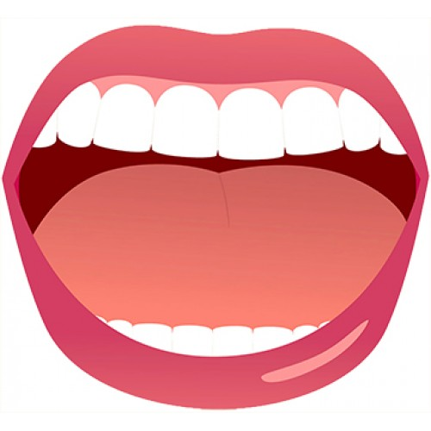
The Big Picture
You are not healthy without a healthy mouth…
Dr. David Satcher, Surgeon General Report 2000
6
Notes:
6
6
If appropriate, remind participants of this idea introduced in the introductory FLHW module. Dr. Satcher introduced this concept in the Surgeon’s General’s Report in 2000.
We are not healthy without a healthy mouth.
His report documented that oral disease was common, had severe consequences, involved disparities that included socioeconomic factors, and was preventable.
To achieve good overall health people need their teeth and mouths in good shape because of the many links between oral and systemic disease. Let’s see how this applies to children.
Reference
US Department of Health and Human Services. Oral health in America. A Report of the Surgeon General. Rockville, MD: US Department of Health and Human Services, National Institute of Dental and Craniofacial Research, National Institutes of Health; 2000. http://www.nidcr.nih.gov/AboutNIDCR/SurgeonGeneral/
**************************************

Slide 7
Consider these National Statistics
Most children have a regular health care provider, for well check ups and sick care - but many lack a dental provider
Children are over 2x more likely to lack coverage that pays for dental care than medical care
The number of dentists are declining , especially those that accept public insurance (Medicaid)
Dentists often uncomfortable working with young children and those with special health care needs
13% of 2-19 year olds have untreated dental decay
Notes:
Although poor oral health is a major societal problem, there is evidence supporting the benefits of change. However, access to care remains a major issue.
Consider the following national statistics:
Though most patients have a medical home, many lack a dental home.
In 2023 census, 95% of children have medical insurance, 10.3% do not have dental benefits.
Children are over 2 times more likely to lack dental coverage than medical coverage.
Dentists per capita are declining, especially those that accept Medicaid insurance.
Dentists are often not comfortable with special populations such as young children, pregnant women or adults with special needs.
Rate of untreated tooth decay is 13% among youth aged 2–19 years
References
Katherine Keisler-Starkey and Lisa N. Bunch, U.S. Census Bureau, Current Population Reports, P60-278, Health Insurance Coverage in the United States: 2021, U.S. Government Publishing Office, Washington, DC, September 2022
Fleming E, Afful J. Prevalence of total and untreated dental caries among youth: United States, 2015–2016. NCHS Data Brief, no 307. Hyattsville, MD: National Center for Health Statistics. 2018.
**************************************
Speaker: There is some planned redundancy in this deck from the first module. This helps emphasize key points and refocuses the audience on child oral health.
As the first module may not be included in the training or offered at a different time, this redundancy helps ensure that all participants have the same basic information at the beginning of this module.
Remember you can hide any slide is not perceived as relevant to your learning experience by right-clicking and selecting the “Hide Slide” feature at the bottom or click the Slide Show tab and select “Hide Slide”.

Slide 8
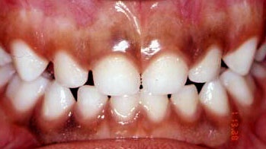
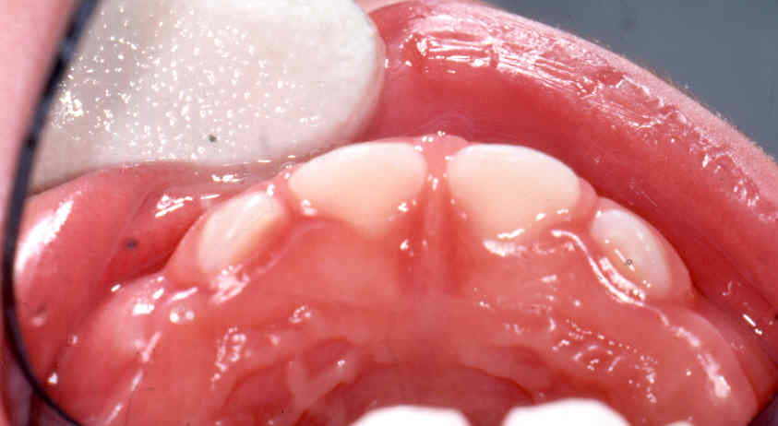
Healthy Teeth
What do you notice?
Photos: Joanna Douglass, BDS, DDS
Notes:
What do you notice?
Healthy teeth should be creamy white with no deviation in color, roughness, or other irregularities.
What do you typically see when you talk to clients and their children?

Slide 9
Primary Teeth Are Important
Speech development
Appearance and self-esteem
Chewing and nutrition
Save space for permanent teeth
Image: Thinkstock.com
Notes:
Healthy primary (baby) teeth:
Assist in speech development
Improve appearance and build self-esteem though a beautiful smile
Foster good nutrition through proper chewing
Space maintainer in the jaw required for proper development of permanent (adult) teeth
Enable children to pay attention and learn in school without dental pain

Slide 10
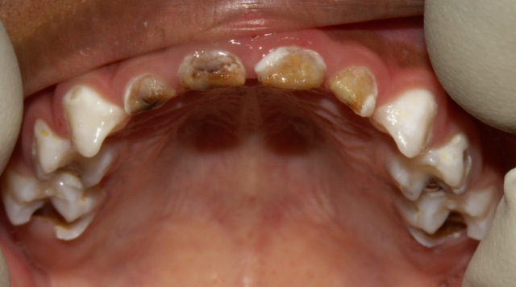
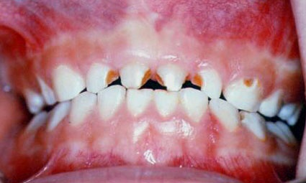
Tooth Decay
Destroys the tooth causing:
Pain
Infection
Difficulty chewing
Upper front, center teeth are least protected, so are affected first
Photos: Joanna Douglass, BDS, DDS
Notes:
What is Tooth Decay?
Tooth Decay is a disease called Early Childhood Caries. It is chronic, infectious process that destroys tooth structure leading to loss of chewing function, pain, and infection in children up to five years of age.
Etiology
ECC was once called "nursing caries" or "baby bottle tooth decay."
Now the disease is called ECC as a variety of feeding habits are implicated.
Other known variables include socioeconomic status, access to dental care, fluoride exposure, and family caries experience.
Progression
Upper front teeth that are least protected by saliva are affected first.
Disease moves posteriorly as teeth emerge.
Reference
Tinanoff N, Kanellis MJ, Vargas CM. Current understanding of the epidemiology, mechanisms, and prevention of dental caries in preschool children. Pediatr Dent. 2002;24(6):543-51.

Slide 11
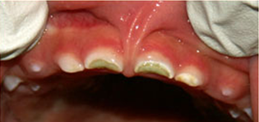
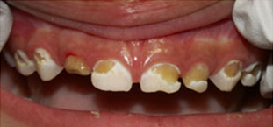
Prevalence
Tooth decay in primary teeth affects:
1 in 5 of children ages 2-5 years
2 or more times higher in certain ethnic groups
Up to 70% of Native American children
Photos: Joanna Douglass, BDS, DDS
Source: Center for Disease Control Prevention, 2015. Dental Caries and Sealant Prevalence in Children and Adolescents in the United States, 2011–2012.
Notes:
Prevalence
How common is tooth decay?
Tooth decay in children ages 5 and under (Early Childhood Caries = ECC) is a public health crisis and the most common chronic disease in children.
Consider the following statistics:
ECC is five times more common than asthma.
30% to 50% of low income children have ECC.
The overall prevalence of ECC in children two to five years old is 18 to 20%.
80% of dental caries occurs in 20 to 25% of children.
Up to 70% of Native American children may have ECC.
Many cases of ECC are undiagnosed, usually because parents or caregivers do not seek dental care at an early age for their children. Clinicians can play a major role in preventing ECC and initiating early treatment.
References
US Department of Health and Human Services. Oral health in America. A Report of the Surgeon General. Rockville, MD: US Department of Health and Human Services, National Institute of Dental and Craniofacial Research, National Institutes of Health; 2000. http://www.nidcr.nih.gov/AboutNIDCR/SurgeonGeneral.
Fleming E, Afful J. Prevalence of total and untreated dental caries among youth: United States, 2015–2016. NCHS Data Brief, no 307. Hyattsville, MD: National Center for Health Statistics. 2018.

Slide 12
Child Oral Health
of tooth decay
of children
How can we live with those numbers and say we are doing everything we can?
- Ralph Fuccillo, President of DentaQuest Foundation
Notes:
It should be noted that, although dental disease affects people of all socioeconomic groups, ethnicity, culture, and education level, a small percentage of children actually bear the majority of the burden of the disease. Of the approximately 25% of all children with tooth decay, a quarter (¼) of those children have 80% of the total tooth decay, a very disproportionate amount of the disease. We need to reach that 25% of the population!
Reference
Oral Health in America: A Report of the Surgeon General. Rockville, MD: U.S. Department of Health and Human Services, National Institute of Dental and Craniofacial Research, National Institutes of Health, 2000. www.surgeongeneral.gov.

Slide 13
Early Sign of Tooth Decay
White spots can be an early sign of tooth decay
Photo: Joanna Douglass, BDS, DDS
White spots should be seen by a dentist
Baby teeth matter!
Notes:
White spots can be an early sign of tooth decay.
White spots should be evaluted by a dentist.

Slide 14
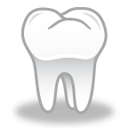
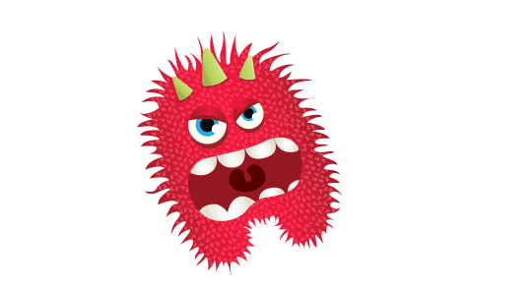
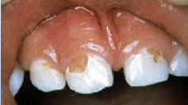
Cause of Tooth Decay
14
Teeth
Bacteria
Carbohydrate
Oral bacteria
+ Sugar
_____________
= Acid
Cavities
Time
Tooth Decay
Decay
Notes:
Let’s take a step back and talk about what causes tooth decay, so that we can consider ways to prevent it.
What Causes Dental Decay?
Tooth decay is a multi-step process that results in destruction of the tooth structure.
The bacteria in the mouth (mutans streptococci) convert the sugar from carbohydrates in our diet to acid. The acid takes away the minerals in the tooth enamel.
Not all carbohydrates are bad, but things to avoid or limit are sugary cereals, stick foods, cakes, jams, jellies, sugary drinks.
If the cycle of acid production and demineralization continues, the enamel will weaken and break down into a cavity (the actual hole in the tooth).
References
Fisher-Owens SA, Gansky SA , Platt LJ et al. Influences on Children's Oral Health: A Conceptual Model. Pediatrics. 2007. Vol. 120(3): pp. e510 -e520.
Colak H, Dülgergil CT, Dalli M, Hamidi MM. Early childhood caries update: A review of causes, diagnoses, and treatments. J Nat Sci Biol Med. 2013;4(1):29-38.

Slide 15
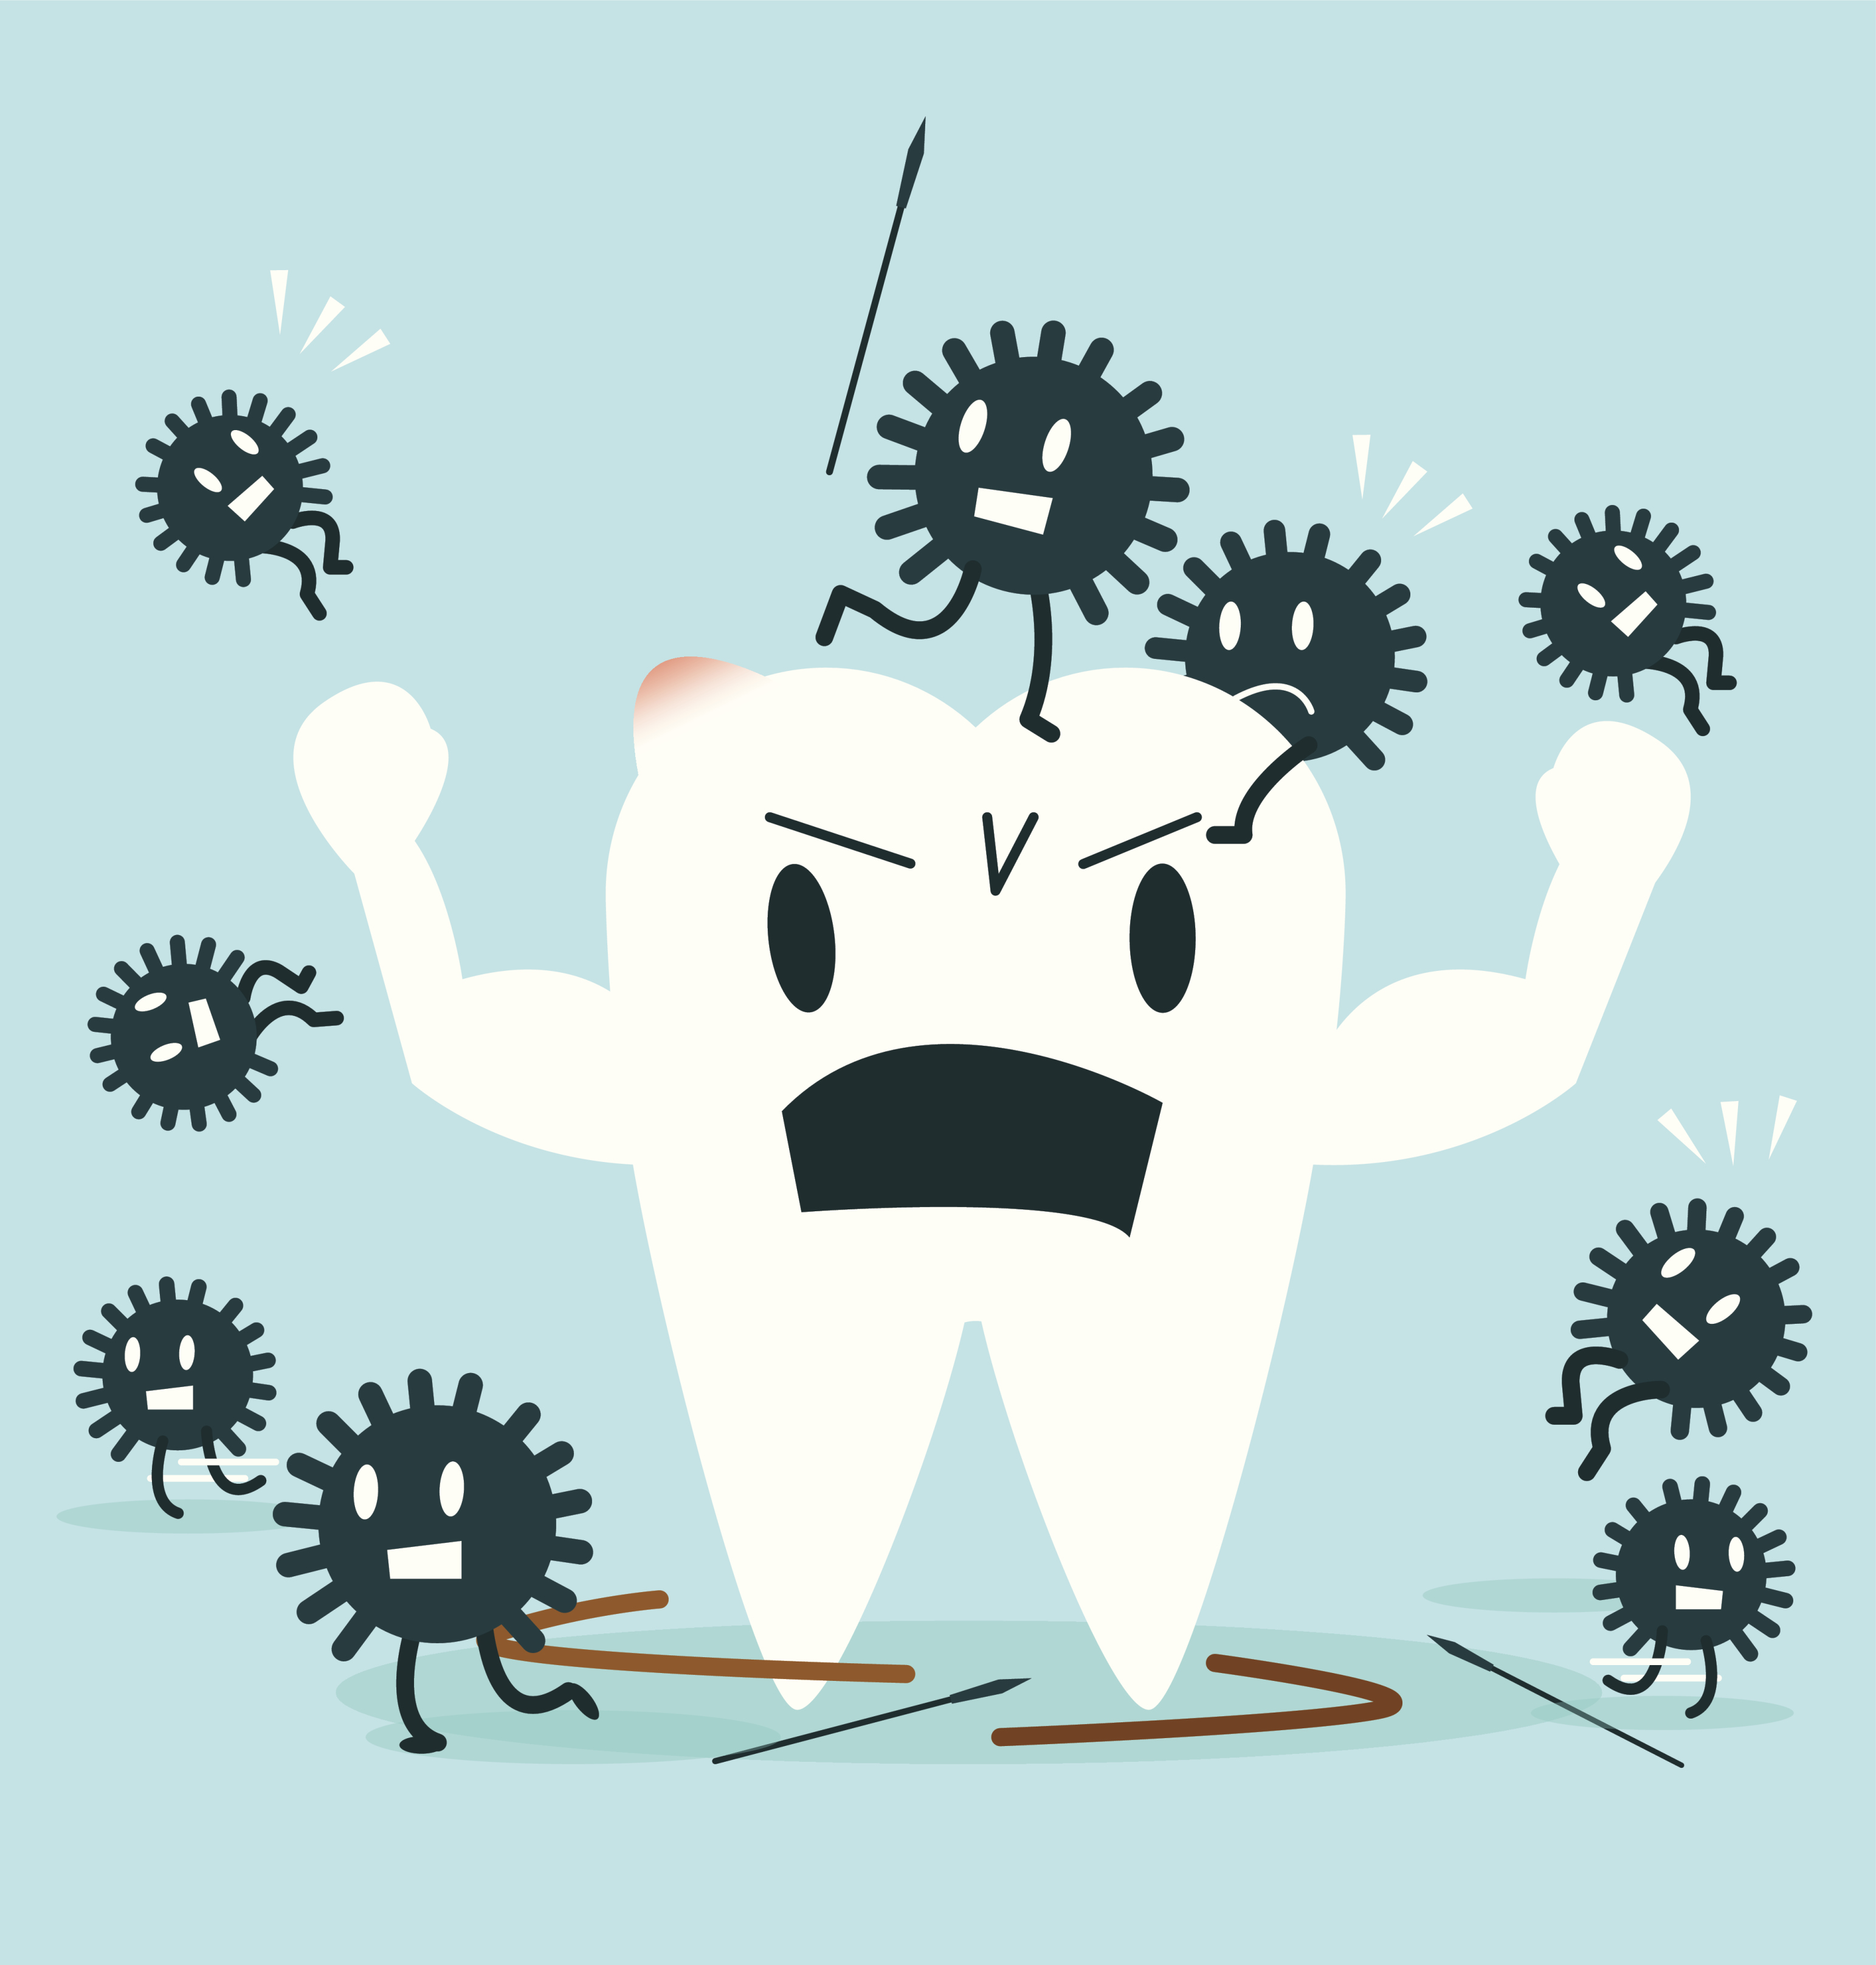
Bacteria: A Closer Look
Parents and caregivers can transfer oral bacteria to their children
Risk of passing bacteria can be lowered:
Obtain dental care
Limit sugar in the diet
Maintain good oral hygiene
Use fluoride-containing toothpaste
Use antibacterial mouth rinse and chew xylitol gum
Don’t share eating utensils, toothbrushes, cups, or straws
Image: Thinkstock.com
Notes:
Unhealthy bacteria are transferred from the child’s primary caregiver, typically the mother. The higher the bacteria level in the caregiver's mouth, the more likely the child will be exposed to and retain the bacteria (become colonized with mutans streptococci).
Caregivers with high bacteria levels usually have:
A high frequency of sugar intake
Poor oral hygiene
Many cavities (High levels of dental caries)
There is promising evidence showing that caregivers can decrease their risk of passing on the bacteria (mutans streptococci) to their children by decreasing their own caries levels. Strategies include:
Receiving regular comprehensive dental care
Limiting the frequency of sugar in the diet
Maintaining excellent oral hygiene and using a fluoride containing toothpaste
Using preventive agents, in appropriate age groups, such as :
Topical fluorides
Anti-bacterial mouthrinses such as chlorhexidine
Xylitol containing gums
Reference
Weintraub JA et al. Mothers' caries increases odds of children's caries. J Dent Res. 2010; 89(9):954-8.

Slide 16
It’s not just what we eat, but how often
Teeth need “time-outs” to protect from decay
Acid remains 20–40 minutes after sugar enters the mouth, until neutralized by saliva
Acids weaken the tooth enamel
If sugars are consumed frequently = more acid attacks = tooth decay
Notes:
It's not just WHAT, but HOW, children eat:
Oral bacteria produce acids that persist for 20–40 minutes after sugar ingestion.
Oral acids weaken the enamel surface. Acid is finally neutralized by saliva.
If sugars are consumed frequently, there is insufficient time for the remineralization process to occur. The tooth is subjected to continued weakening and eventually breaks down into a cavity (cavity = hole in the tooth).
If sugar is consumed infrequently, teeth are able to fully remineralize and the process halts.

Slide 17
Risk Factors for Tooth Decay
Low socioeconomic status
Cultural factors
Enamel defects
Caries in child, siblings or caretakers
Feeding habits
Poor oral hygiene
Inadequate exposure to fluoride
Special health care needs
Notes:
Tooth Decay Risk Factors include:
Lower SES–families statistically have higher rates of tooth decay – note that this is a population-based, not individual, risk factor
Cultural factors – eating habits, lack of trust in public water supply, etc.
Poor access to health care
Family members have cavities – maternal tooth decay within the last 2 years is the greatest risk factor
Feeding
Drinks or eats sugar containing foods two or more times between meals
Prolonged exposure to sugar (e.g. bottle or cup in bed) and coating pacifiers in honey or sugar
Poor oral hygiene (not brushing twice daily with fluoride toothpaste)
Inadequate exposure to fluoride (toothpaste, community water)
Special health care needs - chronic medical or psychological conditions, especially those that
Interfere with oral hygiene (e.g. tactilely defensive or oral aversion)
Require frequent oral feedings or medications that contain sugar
Require medications that decrease saliva production
Also if the teeth themselves form abnormally, there is a higher risk of tooth decay occurring:
Plaque
Presence of white spots or cavities
Developmental defects are seen in 20-40% of children (such as babies born prematurely)
Reference:
Jacobsen PE, Haubek D, Henriksen TB, et al. Developmental enamel defects in children born preterm: a systematic review. Eur J Oral Sci. 2014; 122(1):7-14
National Institutes of Health. Oral Health in America: Advances and Challenges. Bethesda, MD: US Department of Health and Human Services, National Institutes of Health, National Institute of Dental and Craniofacial Research, 2021.

Slide 18
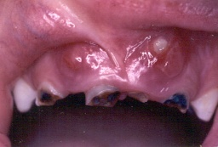
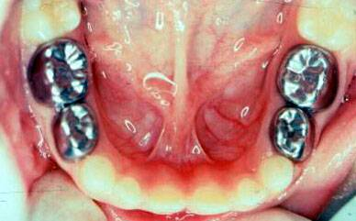
Impact of Early Tooth Decay
Pain
Chewing and nutrition problems
Infection
Increased cavities in permanent teeth
School/work absences
Difficulty sleeping
Poor self-esteem
Children with dental pain over 3x more likely to have a lower grade point average
Photo: Donald Greiner, DDS, MS
Photo: Joanna Douglass, BDS, DDS
Notes:
Early tooth decay (ECC= early childhood caries) is the most common chronic childhood disease and has many potentially severe consequences, including:
Pain
Impaired chewing and nutrition
Infection
Increased cavities in permanent teeth
School/work absences
Students with dental pain are over 3 times more likely to have a lower grade point average
Difficulty sleeping
Poor self-esteem
Extensive and expensive dental work which often must be completed under general anesthesia
References
Krol DM, Whelan K. AAP SECTION ON ORAL HEALTH; Maintaining and Improving the Oral Health of Young Children. Pediatrics January 2023; 151 (1): e2022060417. 10.1542/peds.2022-060417
Jackson SL et al. Impact of Poor Oral Health on Children's School Attendance and Performance. Am J Public Health. 2011; 101(10):1900-6.
Seirawan H, Faust S, Mulligan R. The impact of oral health on the academic performance of disadvantaged children. Am J Public Health. 2012 102(9):1729-34.
Martins-Júnior PA, Vieira-Andrade RG, Corrêa-Faria P et al. Impact of early childhood caries on the oral health-related quality of life of preschool children and their parents. Caries Res. 2013
Pitts NB, Zero DT, Marsh PD, et al. Dental caries. Nat Rev Dis Primers. 2017; 3:17030.; 47(3): 211-8.

Slide 19
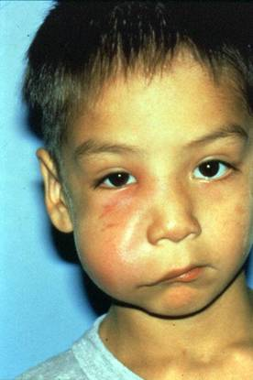
Oral Bacteria Can Spread…
19
Mouth
Sinuses
Face and neck
Brain
Through the bloodstream to other parts in the body
Untreated oral infections can spread and become life threatening
Photo: ICOHP
Notes:
Infections of the tooth often do not remain in the tooth and spread to cause infections in the jaw, face (as shown in the picture above), brain, and even to distant sites through the bloodstream.
References
Manchanda S, Sardana D, Liu P, et al. Horizontal Transmission of Streptococcus mutans in Children and its Association with Dental Caries: A Systematic Review and Meta-Analysis. Pediatr Dent 2021; 43(1):E1-E12.
Weintraub JA et al. Mothers' caries increases odds of children's caries. J Dent Res. 2010; 89(9):954-8.
Zhan L, Tan S, Den Besten P, Featherstone JD, Hoover CI. Factors related to maternal transmission of mutans streptococci in high-risk children-pilot study. Pediatr Dent. 2012; 34(4): e86-91.

Slide 20
Dental Pain
Communicating pain is difficult for many children
Behavioral signs of pain include:
Pulling at face
Not eating
Crying and sleeping poorly
Child should be checked for:
Cheek and gum swelling
Broken, decayed, or loose teeth
Ulcers or infections
Artwork: Joseph Wrightson
Notes:
Communicating pain is often difficult for children and patients with disabilities. Oral pain may be vague and hard to localize.
Behavioral signs of pain include:
Pulling at face
Not eating, sleeping poorly
Crying, whining
Signs that may indicate pain include:
Cheek or gum swelling
Broken, decayed, or loose teeth
Ulcerations

Slide 21
Prevention
Oral health education
Tooth brushing
Fluoride
Diet
Dental care
Image: Shutterstock.com
Notes:
Prevention matters! Tooth decay is a preventable disease and the support you provide your clients can help keep them healthy.
You can help your community understand how these prevention strategies can help protect their teeth from harmful bacteria that cause decay.

Slide 22
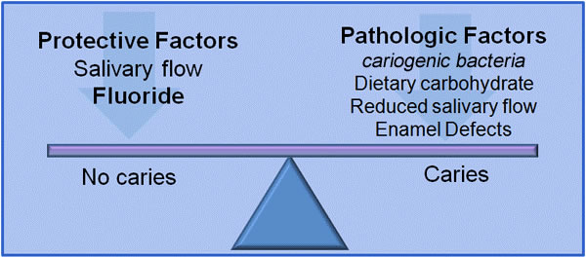
Preventing Cavities
Tooth brushing
Fluoride
Healthy diet
Dental care
Dietary sugar
Poor dental hygiene/care
Dry mouth
Graph adapted from Featherstone JD, 2013.
Notes:
Developing Cavities is a Process
We are trying to tip the scale toward prevention and protection, fighting off tooth decay
We want to limit the number of times teeth are exposed to acid and by decreasing the frequency of eating sugary foods
We can also make teeth more resistant to acid through the use of fluoride
Reference
Featherstone JD, Adair SM, Anderson MH et al., Caries management by risk assessment: Consensus statement, April 2002. J Calif Dent Assoc. 2003;31(3);257-69.

Slide 23
Tooth Brushing
Courtesy of From the First Tooth – with permission
www.youtube.com/watch?v=1uy3laXAYVQ
Notes:
***************************************
Speaker: Subsequent slide has much of this information in bullet point form, important information for FLHW to transmit to families.
Lift the lip and brush all tooth surfaces, especially along the gum line
Use small backwards and forwards brushing movements or small circles
Instruct child to spit out toothpaste and do not rinse mouth after brushing
No food or drink after brushing
Begin flossing daily once teeth touch

Slide 24
Tooth Brushing
Wipe gums after feeds before teeth erupt
Brush twice daily as soon as teeth erupt
Bedtime is most important time
Use soft toothbrush
“Just spit” - Do not rinse mouth after brushing
No food or drink after brushing
Floss daily between teeth that touch
Image: Rocio Quinonez, DMD, MS, MPH
Notes:
Often families receive no formal instruction in correct brushing.
Encourage patients to follow these guidelines:
Before teeth erupt, recommend caregivers wipe the gums after all feeds.
Brush twice daily. Bedtime is most critical due to decreased salivary flow.
The caregiver should stand or sit behind the child and brush all surfaces of each tooth.
Lift lip to allow proper visualization.
Brush along the gum line where decay commonly begins, both on the outside and inside of the tooth.
Brush the top chewing surfaces.
Use small backwards and forwards brushing movements or small circles.
Spit out toothpaste and don't rinse after brushing.
No food or drink after brushing.
Begin flossing daily once teeth touch.
Caregiver should brush child's teeth until age 8 or 9, at least until they have developed the manual dexterity to write in cursive or tie their own shoes.
Make tooth brushing fun!
Sing a song that lasts 2 minutes and brush until done.
Sing the alphabet and brush each quadrant until done.
Brush in front of mirror
Use an electric toothbrush featuring timers, lights, or favorite characters.
**********************************
Speaker: If video on previous slide was shown, this slide may be redundant and speaker may wish to hide the slide. FLHW are often looking for specific advice to give clients and families, so including this slide with specific ideas may be of value, even if the video is shown.

Slide 25
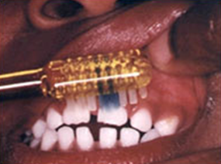
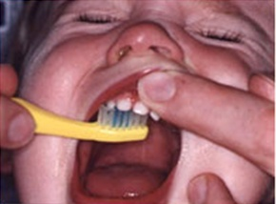
Brushing Techniques
Lift the lip
Brush behind teeth
Lift the lip and brush all tooth surfaces, especially along gum line
Brush using small backward and forward movements or small circles
Photos: Joanna Douglass, BDS, DDS
Notes:
If video on earlier slide was shown, this slide may be redundant and speaker may wish to hide the slide. FLHW are often looking for specific advice to give clients and families, so including this slide with specific ideas may be of value, even if the video is shown.
Often families receive no formal instruction in correct brushing.
Encourage patients to follow these guidelines:
The caregiver should stand or sit behind the child and brush all surfaces of each tooth.
Lift lip to allow proper visualization.
Brush along the gum line where decay commonly begins, both on the outside and inside of the tooth.
Brush the top chewing surfaces.
Use small backwards and forwards brushing movements or small circles.
Spit out toothpaste and don't rinse after brushing.
No food or drink after brushing.
Begin flossing daily once teeth touch.
Make tooth brushing fun!
Sing a song that lasts 2 minutes and brush until done.
Sing the alphabet and brush each quadrant until done.
Brush in front of mirror
Use an electric toothbrush featuring timers, lights, or favorite characters.
**********************************
Speaker: If video on previous slide was shown, this slide may be redundant and speaker may wish to hide the slide. FLHW are often looking for specific advice to give clients and families, so including this slide with specific ideas may be of value, even if the video is shown.

Slide 26
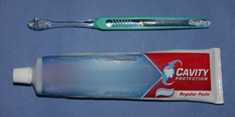
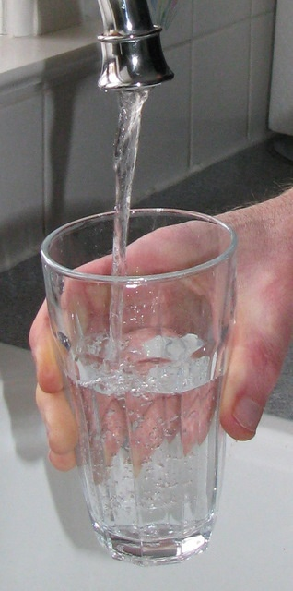
Fluoride
Fluoride is very important in preventing tooth decay
Sources of fluoride:
Water
Toothpaste
Mouthrinse
Fluoride varnish, gel, foam
All professionally applied
Prescription fluoride supplements
Photos: Joanna Douglass, BDS, DDS
Notes:
Fluoride is probably the most important method of preventing tooth decay.
The use of fluoride, both through dietary and topical applications, has led to dramatic drops in caries rates.
The topical effect of fluoride is the most important. It needs to be placed on the surfaces of the teeth, in appropriate amounts, on a regular basis, to prevent tooth decay.
Caregivers should brush the teeth using fluoridated toothpaste twice daily starting from first tooth eruption
Use fluoride toothpaste as soon as the first tooth erupts Drink community water that contains fluoride. Drinking fluoridated water allows fluoride to strengthen the developing teeth, as well as the important topical effect of teeth already in the mouth
Topical fluoride is especially effective for children at high risk for tooth decay who lack fluoridated water, have a history of tooth decay, snack frequently on foods containing sugar, or have a medical condition that makes them susceptible to decay.
Topical fluoride works best when ingested in very small amounts many times a day through water, foods containing fluoride, and fluoridated toothpaste.
What are the primary sources of fluoride?
Water fluoridation
Dietary fluoride supplements
Fluoride toothpastes
Fluoride varnish
Gels, foams, mouthwashes
Fluoride can also be professionally applied (including gels, foams, and varnish to renew fluoride levels in the enamel. Only a dentist, dental hygienist, physician, or other qualified health professional should apply topical fluoride.
References
Centers for Disease Control and Prevention (1999). Achievements in public health, 1990–1999: fluoridation of drinking water to prevent dental caries. MMWR; 48: 933–940.
American Academy of Pediatric Dentistry. Fluoride therapy. The Reference Manual of Pediatric Dentistry. Chicago, Ill.: American Academy of Pediatric Dentistry; 2023:352-8.
Clark MB, Keels MA, Slayton RL; AAP Section on Oral Health. Fluoride use in caries prevention in the primary care setting. SECTION ON ORAL HEALTH. Pediatrics. 2020; 146 (6).

Slide 27
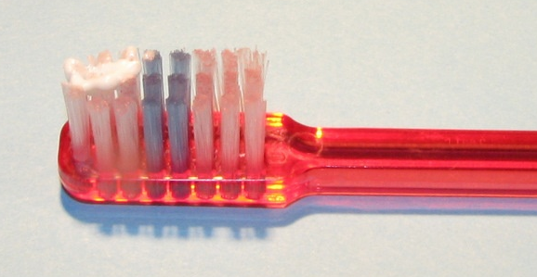
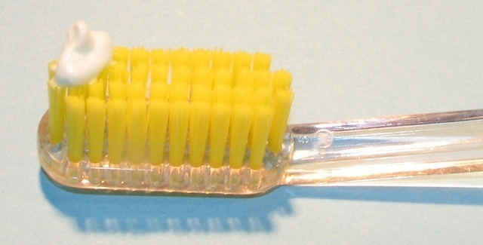
How Much Toothpaste?
Small smear or “grain of rice”: Less than 3 years of age
Pea sized:
All children ages 3 and older
Most preschool children swallow toothpaste on the brush
Encourage spitting, but small amounts safe to swallow
Keep toothpaste tubes out of reach of small children
Photos: Joanna Douglass, BDS, DDS
Notes:
Excessive ingestion of toothpaste can cause fluorosis which is a minor cosmetic problem, relative to losing teeth to caries. In rare situations, such as consuming a large portion of a family sized tube, children can become ill enough to require emergency care.
Guidelines
Use a small smear for children less than 3 years old (size of a grain of rice).
Apply a pea-sized amount of toothpaste for children three years and older regardless of caries risk status.
Most preschool children swallow much of the toothpaste placed on the brush. These guidelines take this into account and these amounts are safe to swallow, but spitting out should always be encouraged.
Parents should keep toothpaste tubes out of reach of small children.
References
American Academy of Pediatric Dentistry. Fluoride therapy. The Reference Manual of Pediatric Dentistry. Chicago, Ill.: American Academy of Pediatric Dentistry; 2023:352-8.
Clark MB, Keels MA, Slayton RL; AAP Section on Oral Health. Fluoride use in caries prevention in the primary care setting. SECTION ON ORAL HEALTH. Pediatrics. 2020; 146 (6).
Krol DM, Whelan K. AAP SECTION ON ORAL HEALTH; Maintaining and Improving the Oral Health of Young Children. Pediatrics January 2023; 151 (1): e2022060417. 10.1542/peds.2022-060417

Slide 28
Diet and Oral Health
28
Introduce sippy cup at 6 months, monitor use
No bottle to bed, wean bottle by 12 months of age
Do not eat or drink before bed after brushing teeth
Encourage children to drink water
Safest drink for tooth decay
No calories
Juice
Do not serve to infants under 1 year of age
Limit juice intake at all ages
Serve only 100% fruit juice, no “fruit drinks”
Notes:
Diet can also play an important role in oral health.
Follow these tips to lower caries risk:
Encourage breastfeeding – there is a lower risk of tooth decay as well as numerous other health benefits
Encourage drinking of water, its sugar-free and may contain fluoride to promote tooth health
Introduce a cup at six months
No bottle to bed, wean off the bottle by 12 months
Toddlers should not be given juice or other sugary drinks from bottles or easily transportable covered cups that allow them to drink easily throughout the day.
Fruit juice offers no nutritional benefits over whole fruit for infants and children and has no essential role in healthy, balanced diets of children.
100% fresh or reconstituted fruit juice can be a part of the diet of children older than 1 year when consumed as part of a well-balanced diet. Fruit drinks are not nutritionally equivalent to fruit juice.
American Academy of Pediatrics (AAP) Recommendations - 2017
Juice should not be introduced into the diet of infants before 12 months of age unless clinically indicated and limited to the amounts on the slide. Fruit juice offers no nutritional benefits for infants younger than 1 year.
Children should be encouraged to eat whole fruit to meet their recommended daily fruit intake rather than relying on fruit juice.
Over-consumption of fruit juice contributes to overweight, obesity, tooth decay, diarrhea, poor nutrition.
Families should be educated that human milk and/or infant formula is sufficient for infants and low-fat/nonfat milk and water are sufficient for older children.
No juice at bedtime.
Reference
Heyman MB, Abrams SA, Fruit Juice in Infants, Children, and Adolescents: Current Recommendations. AAP SECTION ON GASTROENTEROLOGY, HEPATOLOGY, AND NUTRITION, COMMITTEE ON NUTRITION. Pediatrics. 2017: 139 (6).

Slide 29
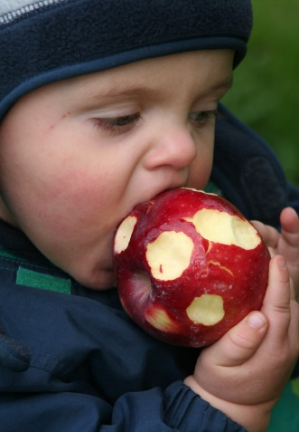
Fruit and Fruit Juice
29
Whole fruit is more nutritious than fruit juice and provides dietary fiber
Drinking fruit juice can contribute to weight gain, tooth decay, diarrhea, and poor nutrition
Juice should be limited at all ages to 4-8 ounces per day
Carbonated water is sugar-free, but acidic and can promote tooth decay
Image: Melinda Clark, MD
Notes:
Whole fruit is more nutritious than fruit juice and provides dietary fiber.
Fruit juice offers no nutritional benefits over whole fruit for infants and children and has no essential role in healthy, balanced diets of children.
Children should be encouraged to eat whole fruit to meet their recommended daily fruit intake rather than relying on fruit juice.
Excessive juice consumption may be associated with malnutrition (overnutrition and undernutrition), diarrhea, abdominal distention, and tooth decay.
Juice should be limited to:
Toddlers: 4 ounces per day or less
Children 4-6 years: 4 to 6 oz/day
Children 7-18 years: 8 oz per day
AAP Recommendations – 2017
Families should be educated that human milk and/or infant formula is sufficient for infants and low-fat/nonfat milk and water are sufficient for older children.
Juice should not be introduced into the diet of infants before 12 months of age unless clinically indicated and limited to amounts listed above.
Fruit juice offers no nutritional benefits for infants younger than 1 year.
Toddlers should not be given juice from bottles or easily transportable covered cups that allow them to consume juice easily throughout the day. Toddlers should not be given juice at bedtime.
Reference
Heyman MB, Abrams SA, Fruit Juice in Infants, Children, and Adolescents: Current Recommendations. AAP SECTION ON GASTROENTEROLOGY, HEPATOLOGY, AND NUTRITION, COMMITTEE ON NUTRITION. Pediatrics. 2017: 139 (6).

Slide 30
Diet and Oral Health
30
Offer snacks only once between meals
If children snack more, brush more frequently
No food or drinks in bed except plain water
Avoid treats in return for good behavior
Bribes teach children to view food as a reward
Image: Shutterstock.com
Notes:
Follow these tips to lower tooth decay risk:
Feeding and eating behaviors influence the development of tooth decay
Snacking is important for infants and small children to meet nutritional requirements.
Remember, frequent consumption of foods containing sugar increases the risk for tooth decay, even if the quantities consumed are small.
Choose healthy foods like fruits, vegetables, whole grains, and dairy products.
Offer snacks at regular times between meals, no food or drinks in bed.
For children who snack more often, brush the teeth 3 or more times per day
Try to avoid bartering food in exchange for good behavior, this encourages the unhealthy habit of rewarding with food

Slide 31
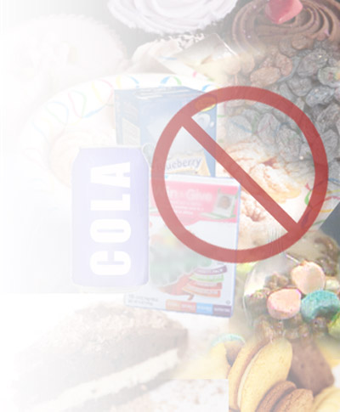
Making the Right Food Choices
Lower Risk Snacks
Fruit
Veggies
Cheese
Popcorn
Nuts
Plain milk
Water
Sugar free gum
High Risk Snacks
Fruit Roll-ups
Gummy bears
Cookies
Cupcakes
Donuts
Granola bars
Pop tarts
Sugared Cereals
Soda, Iced tea
Sugary drinks
Raisins
Images: Photos.com
Images: Photos.com
Remember: frequency of ingestion is important in whether foods cause tooth decay!
Notes:
The types of food that are higher-risk for tooth decay are also foods that are generally considered “unhealthy” because they also contribute to weight gain and weight-related health problems like high blood pressure and diabetes.
Higher risk foods and snacks should be offered infrequently.
Remember, although the types of food chosen are important, the frequency of ingestion is more important in developing tooth decay! The message here is moderation.
Some foods on the healthy list (e.g. nuts and chewing gum) are not appropriate for children under age 3, due to risk of choking.

Slide 32
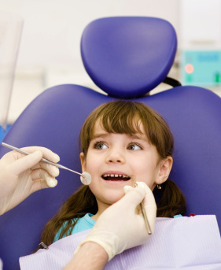
Dental Home
A dental home is the ongoing relationship between the dental provider and child for oral health care
All children should establish a dental home by age 1
Image: Thinkstock.com
Notes:
How else do we keep our mouths healthy?
Do all children have access to a dental provider?
Access to dental care is important.
A dental home is the ongoing relationship between the dental provider and child for oral health care.
All children should establish a dental home at age 1.
Dentists will provide:
Provide preventive services including:
Fluoride varnish
Cleanings/exam
Anticipatory guidance
Sealants
Manage dental trauma
Comprehensive evaluation and diagnosis of oral disease

Slide 33
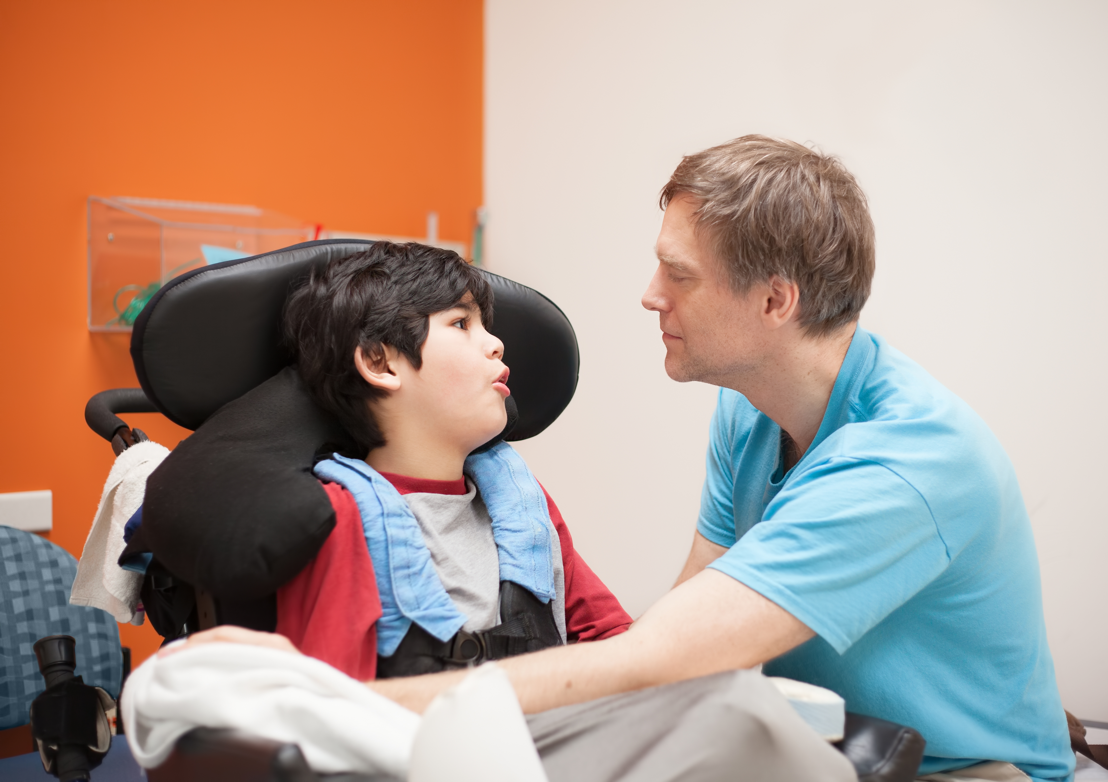
Special Care Needs Considerations
33
Defensiveness with hygiene & exams common
May require more intense oral hygiene care
Prepare for dental visits: child, parent, dentist
Often see a pediatric dentist
May need more frequent dental visits
Image: Shutterstock.com
Notes:
Children with special health care needs (SHCN) are a special group that encompass a wide range of medical and behavioral issues, as well as abilities.
These children have special considerations when it comes to oral health.
In general, some thought should be given to the following:
Children with SHCN often require more intense oral hygiene, brushing and flossing to prevent tooth decay.
This is particularly challenging in children with oral aversion or tactile defensiveness, who may gag, bite, or not be able to handle secretions
Everyone involved in the oral health care of the child needs to be prepared for dental visits: the child, the parent and the dentist
Prepare for dental visits: The child and caregivers need to know what to expect at a dental visit. Visiting the office prior to the visit and reading books about seeing the dentist can help to manage anxiety. Also, the dentist caring for the child should be given information about the child in advance so that the office can be prepared to welcome the child and keep them comfortable (e.g. child may need a quiet space)
Most children with special health care needs will see a pediatric trained dentist
These children are often at higher risk for decay, so may need more frequent dental visits
The child’s therapists (especially occupational and speech therapists), pediatrician, and dental team are good resources to help caregivers address special or unique concerns.

Slide 34
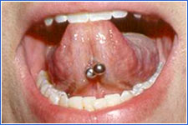
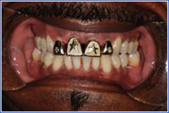
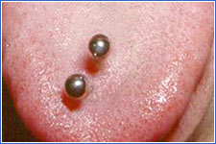
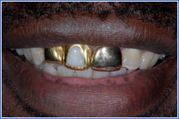
Common Oral Health Questions
Offer education to clients about:
Pacifier and Thumb Sucking
Teething
Injury Prevention
Oral Piercings and Grills
Nutrition Advice for Children
Advance to Final Slide
Notes:
This slide contains hyperlinks to the above 5 categories.
Nonnutritive Sucking
Teething
Injury Prevention
Oral Piercings and Grills
Nutrition advice for children
***************************************
Speaker: Ask the audience which of the topics on the slide above they are most interested in and discuss those most applicable to their work (each topic is explored in 1-2 slides). Use the mouse to click on one of the topics. At the top of each slide is a red “reverse” arrow to return to this page to select another topic and a blue forward arrow to advance to the end of the PowerPoint and the True/False questions. If the slide does not contain a blue and red hyperlink arrow, simply advance to the next slide of similar content. If time allows and the audience is interested, you can also elect to advance through all the slides (total of 8). If time is limited, all 9 of these “extra” slides can be hidden.

Slide 35
Pacifier and Thumb Sucking
Concern: If habit persists, may delay speech and affect the child’s bite
Guidance
Satisfies a psychological need in babies
Stop habit by 3 years, especially if bite and teeth position affected
Break the habit:
Limit opportunity (bed only)
Cover hands at night; Provide another comfort object
Pacifiers preferable to finger or thumb sucking
Never dip pacifier in honey or other sweet food
Image: Shutterstock.com
Notes:
Pacifier and thumb and finger sucking satisfies a psychological need and decreases as the child ages; most stop at two to four years. It increases the risk of anterior open bite and delayed speech development if the habit persists.
Anticipatory Guidance
Intervene to stop habit by 36 months, especially if changes to bite are noted.
Offer positive reinforcement, such as a star chart or stickers.
Restrict opportunity (only bed, naps, stressful times).
Cover hands at night with mittens.
Provide stuffed animal or other comfort object. In general, pacifier use is preferable to digit sucking as it is less likely to cause a problem and the habit is easier to break (the pacifier can be removed).
Recommend never to dip pacifier in honey or other sweet food.
Reference
Nowak AJ and Warren JJ. Infant oral health and oral habits. Pediatric Clinics of North America 2000;47(5):1043-1066.

Slide 36
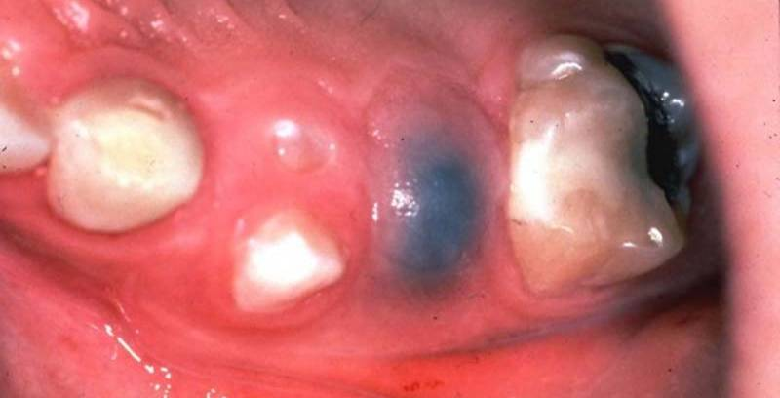
Teething
Concerns
Teething does not cause fever, colds, ear infection, or diarrhea
Teething may cause fussiness
Drooling is common at this age
Erupting Tooth with Hematoma
Guidance
Apply cold teething ring or cloth to gums
Provide over the counter pain medication if necessary
Avoid teething gels (dangerous for infants)
Tooth emergence may be preceded by a collection of blood in the tissues (above) - no treatment necessary
Photo: ICOHP
Notes:
Concerns
Teething does not cause fever, upper respiratory infection, ear infection, or diarrhea. If the child has fever, another source of infection should be looked for (perhaps a visit to the pediatrician).
Teething may cause fussiness.
Drooling is developmentally common at this age.
Anticipatory Guidance
Apply cold teething ring or cloth to gums.
Provide acetaminophen or ibuprofen if necessary.
Avoid teething gels—they are not effective and contain high doses of topic anesthetics which can be dangerous in infants.
Avoid alcohol on teethers as alcohol is harmful for baby development.
Remember tooth emergence may be preceded by a hematoma—no treatment is needed in primary dentition.
The blue area in the photo is blood covering an erupting tooth –an eruption hematoma.
Reference
Wake M, Hesketh K, Lucas J. Teething and tooth eruption in infants: A cohort study. Pediatrics. 2000;106(6):1374-9.

Slide 37
Oral Injury
Oral injuries are common in young children
> 30% of preschoolers have had a dental injury
Causes of injury
Young children:
Falls off of furniture
Running and tripping
Injured with object
Older children:
Sports and outdoor activities (e.g. biking, skateboarding)
Image: Shutterstock.com
Notes:
Oral injuries are a common occurrence in young children
Most injuries happen from falls
Center top front teeth are injured most frequently
What can we do?
Recommend use of safety gates, cover sharp edges on furniture, have children wear helmets when riding toys with wheels, regularly keep toys picked up so the play area is free of things that cause children to trip and fall
A well-fitting mouth guard can decrease risk of injury and by separating the mandible from the base of the skull, mouth guards may also reduce risk of cerebral and dental concussion.
Recommend clients to use a mouth guard. The best are custom fitted and a well fitting mouth guard is most likely to be used consistently.
References
International Association of Dental Traumatology. Dental Trauma Guidelines, Revised 2012. Accessed March 15, 2017
Brush up on oral Health. The National Center on Early Childhood Health and Wellness. April 2017 Newsletter.
Caring for Our Children, National Health and Safety Performance Standards; Guidelines for Early Care and Education Programs, Third Edition
Newsome PR, Tran DC, Cooke MS. The role of the mouth guard in the prevention of sports-related dental injuries: a review. International Journal of Pediatric Dentistry. 2001;11(6):396-404.

Slide 38
Injury Prevention
Top front teeth most frequently injured
Tooth may be chipped, moved forward or backward, pushed back into the gum, knocked out
Injured primary teeth may:
Discolor (turn brown or black)
Cause pain
Become infected
Need to be removed
Affect underlying permanent
tooth development
Image: Rocio Quiñonez, DMD
Notes:
Injuries:
Chipped, pushed forward/ back or into the gum, knocked out
Injured primary teeth can turn brown or black, cause pain, become infected, or have to be removed - may affect self-esteem, ability to learn and eat health foods
Injured primary teeth can affect permanent teeth – primary teeth keep open space for permanent teeth to form; can also damage permanent teeth forming underneath. Can cause discolored or deformed permanent teeth, by disturbing cells building permanent teeth
Injuries to teeth can affect a child’s speech, nutrition, self-confidence and overall health

Slide 39
Oral Piercings
Procedure Risks
Swelling - very common post-piercing
Bleeding
Infection
Jewelry-Related Complications
Injury to the gums and teeth
Problems with hygiene, speech, chewing and swallowing
May be sensitive or allergic to metal
Loose jewelry may be inhaled or swallowed
Photos by Rebecca Slayton DDS, PhD
Notes:
Oral piercings are increasingly popular, but there are significant risks.
Procedure-related risks:
Swelling – most common symptom post-piercing
Prolonged bleeding
Nerve damage
Infection of the lip or tongue
Jewelry-Related Complications:
Injury to the gums and tooth damage, scarring
Interfere with oral hygiene, speech, chewing and swallowing
Allergic/hypersensitivity reaction to metal
Aspiration or ingestion if jewelry becomes loose
The American Academy of Pediatric Dentistry (AAPD) "strongly opposes" the practice of piercing perioral and intraoral tissues use of jewelry on these tissues.
Reference
American Academy of Pediatric Dentistry. Council on Clinical Affairs. Policy on Intraoral and Perioral Piercing. 2003. 33(6): 61 - 62.

Slide 40
Grills
Grill-related Risks
Increase risk of cavities
Allergic reactions to the metal
Counsel grill-wearers to:
Brush and floss regularly
Limit amount of time grill is worn
Remove grill to eat and sleep
Photos by Scott Eidson DDS
Notes:
Grills on the teeth can increase the risk of developing caries and trigger allergic reactions to the metal.
Counsel grill-wearers to:
Remove the grill to eat and sleep
Brush and floss regularly
Limit amount of time the grill is worn
Reference
American Academy of Pediatric Dentistry. Policy on intraoral/perioral piercing and oral jewelry/accessories. The Reference Manual of Pediatric Dentistry. Chicago, Ill.: American Academy of Pediatric Dentistry; 2023:143-4.

Slide 41
Diet Advice: 0 – 12 Months
Strongly encourage breast feeding
Hold infant for bottle feeding
Introduce sippy cup at 6 months
No bottles at bedtime or naptime
Wean off bottle by 12 months
Don’t use sweetened pacifiers
Avoid constant use of sippy cup unless only water
No juice in the first year of life
Snacks should contain no added sugar
Notes:
A quick review on diet…brief, key messages for your clients.
Messaging for infants should focus on encourage:
Breastfeeding
Introducing sippy cup as we work to stop bottle use by 12 months of age
No bottles in bed
No juice in the first year of life
Healthy snack choices, which will promote a lifetime of healthy snack habits

Slide 42
Diet Advice: 1 – 5 Years
Limit juice to 4 oz per day and serve with meals
Avoid carbonated beverages and sugary drinks
Drink plain milk or water between meals
Avoid carbonated water (Seltzer) as the acidity can promote tooth decay
Choose fresh fruits, vegetables, and sugar free whole grain snacks
Limit eating to 3 meals per day and 1 snack between meals
Limit soda, candy, and sweets
Notes:
Messaging for toddlers and preschoolers should focus on:
No juice or limiting juice
Drink water, especially between meals (juice and milk only with meals). No soda.
Healthy snack choices to promote a lifetime of healthy snack habits

Slide 43
Take Home Messages
Image: Melinda Clark, MD
Notes:
******************************************
Speaker: Create your own ending.
What are the take home messages? Ask participants to talk back. Ask participants what their take-away messages are from this course.
Review True or False questions (next slide) if participants filled out a questionnaire at the beginning. If you completed this at the beginning, hide the next slide (#44).
Review the 2 clinical cases on slides 45 and 46 in the large or smaller groups to facilitate conversation and check comprehension.
Ask participants to write one thing they have heard about child oral health on the sticky note or white board that clients in their community believe, but may not be true. Ask participants to weigh in on those questions. Review sticky notes on the walls to be sure that all issues were addressed.
Final Comments:
Particularly in the case of children, we need to all take ownership of oral health… children are, after all, not just the present, but the future of our communities. The earlier we start with prevention, the healthier both the mouth and the child will be.

Slide 44
True or False?
No need to start brushing a child’s teeth until they have > 2 teeth.
Primary teeth are not very important because baby teeth will be replaced.
A child can and should brush their own teeth before age 5.
Children should first see a dentist when they start preschool.
For children who do not like plain water, flavored water and all natural juices are a good substitute, as they don’t cause tooth decay.
A child can fall asleep with a bottle as long as it doesn’t stay in the mouth all night.
Fluoride products are not safe for young children.
Bottled water is better for teeth than tap water.
Children do not need to floss until they have adult teeth.
Dried fruit is better for children’s teeth than chocolate.
A child can get oral bacteria from an adult.
How often children eat may change their risk for cavities.
Notes:
Speaker’s answer key:
You do not have to start brushing a child’s teeth until they have two of them. False – teeth should be brushed upon emergence and the gums wiped before teeth emerge.
Primary (baby) teeth are is not important because those teeth will be replaced. False – ECC is the most common chronic childhood disease and has many potentially severe consequences, including pain, impaired chewing and nutrition, infection, increased cavities in permanent teeth, school absences, poorer academic performance, difficulty sleeping, poor self-esteem, and extensive and expensive dental work which often must be completed under general anesthesia. See slide 18.
A child can and should brush their own teeth before age 5. False – Children should have their teeth brushed until the age of 6 or 7. They generally have the skill to brush their teeth once they can tie their own shoes or write in cursive.
Children do not need to see a dentist until they start preschool. False - A dental home should be established by the age of 1. See slide 32.
For a child who does not like plain water, flavored water and “all natural” juices are a good substitute, as they don’t cause decay. False – All juices and many flavored waters contain Fructose, a natural sugar that bacteria can use to cause tooth decay.
Child can go to sleep with a bottle as long as it doesn’t stay in their mouth all night. False – It is important that the last object to touch the teeth at night be the toothbrush to remove the carbohydrates from the last meal or drink.
Fluoride products are not safe for young children. False - Fluoride products used appropriately are safe and will help prevent tooth decay.
Bottled water is just as good or better for teeth than tap water. This answer depends on whether the tap water is fluoridated. Some bottled water contains fluoride, but this is not usually declared on the bottle except for “nursery water” where fluoride is added. If the community water source is fluoridated, it is better for the teeth to drink tap water, plus it is cheap and saves the environment.
Children do not need to floss until they have adult teeth. False – All teeth that touch should be flossed in between.
Dried fruit is better for children’s teeth than chocolate. False – Dried fruit is actually stickier and more likely to cause cavities than chocolate, fresh fruit is the better health choice!
A child can get oral bacteria from an adult. True – Children teeth are colonized by oral bacteria from caregivers, often their mothers.
How often children eat may change their risk for cavities. True – How all of us eat changes our risk for cavities, both the types of foods we choose and the frequency we consume them.

Slide 45
Case #1
You work for a community health center in a large urban area. A family you serve has recently emigrated from Saudi Arabia. 3-year-old Rayan’s mother is concerned about cavities in his teeth. She reports that his grandmother has reassured her that having cavities at this age is normal and that he does not need treatment.
Are cavities normal in preschoolers?
What advice should be given about baby teeth? Do they matter? Why?
When is the proper age to establish a dental home?
Notes:
**********************************
Speaker: Cases may be appropriate for certain audiences and are intended to provide the speaker options on how to best reinforce the material learned. Cases can be presented by the speaker in the large group forum with audience members offering opinions, or small groups can meet for 3-5 minutes with their table members or in groups of 3 prior to a large group discussion. Select the option best suited for your forum, audience, and allotted time.
*Speakers should feel free to edit the characteristics of the clients or setting in each case to align more closely with the population that the attendees serve.
Sample responses:
Cavities are not ever normal in a person of any age. Cavities are cause by bacteria destroying the enamel of the teeth. Cavities in preschoolers have potentially severe consequences, including pain, impaired chewing and nutrition, infection, increased cavities in permanent teeth, school absences, poorer academic performance, difficulty sleeping, poor self-esteem, and extensive and expensive dental work which often must be completed under general anesthesia.
Baby teeth are very important! They are necessary for a child to chew and speak and they save space for the child's future permanent teeth. A baby tooth usually remains in the child's mouth until a permanent tooth underneath it is ready to emerge through the gums, so it they are lost early, the teeth that are already in the mouth will move into the space. This can cause crowding, crooked teeth, and increase the need for braces in the future. Finally, the bacteria that cause baby teeth to rot will simply move on to the adult teeth if the caries process is not treated.
All children should see a dental provider by the age of 1.

Slide 46
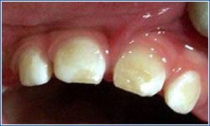
Case #2
Your clients are the Ramos family: Leonel age 5 years and Mary age 4 years. The guardian raises concerns about Mary’s teeth. This is the appearance of her teeth:
What do you notice about the teeth?
What advice would you give the parents about toothbrushing and fluoride?
What advice should be given about the child’s diet/nutrition?
Notes:
*Speakers should feel free to edit the characteristics of the clients or setting in each case to align more closely with the population that the attendees serve.
Sample responses:
The yellow and rough areas on the teeth is enamel that is wearing away. This child has tooth decay of at least the 4 upper, center teeth.
Teeth should be brushed twice daily with fluoride toothpaste. Children should have their teeth brushed for them until the age of 6 or 7. The last object to touch the teeth at night be the toothbrush to remove the carbohydrates from the last meal or drink. All teeth that touch should be flossed in between once per day.
Dietary changes to limit further tooth decay include less snacking, lower-sugar foods, minimizing sticky foods, and eliminating the bottle (especially in bed). Avoid juice as all juices and many flavored waters contain fructose, which is a natural sugar that bacteria can use to cause tooth decay. If the community water source is fluoridated, it is better for the teeth to drink tap water, plus water is inexpensive and good for the environment.
* Also establish care with a dentist ASAP (by age 1 is the recommendation).

Slide 47
Questions?
Image: Jupiterimages/Photos.com
Notes:
Speaker: If time allows, allot a small amount of time for Q & A, may be of particular importance if interactive activities are eliminated from the deck.

